Slide 1






DevOps Essentials
What is DevOps?
DevOps Essentials

Slide 2


Defining DevOps
DevOps = Dev (Development) + Ops (Operations)
Different people define DevOps in a variety of ways. This definition from Wikipedia is a good starting point:
“DevOps is a software engineering culture and practice that aims at unifying software development (Dev) and software operation (Ops)...
DevOps aims at shorter development cycles, increased deployment frequency, more dependable releases, in close alignment with business objectives.”
- Wikipedia (Feb. 2018)

Slide 3

This Course Will Cover…
DevOps Culture – The culture of collaboration between Dev and Ops
DevOps Practices – The practices which support the goals of DevOps culture
DevOps Tools – The tools that help implement DevOps practices
DevOps and the Cloud – The close relationship between DevOps and the cloud

Slide 4

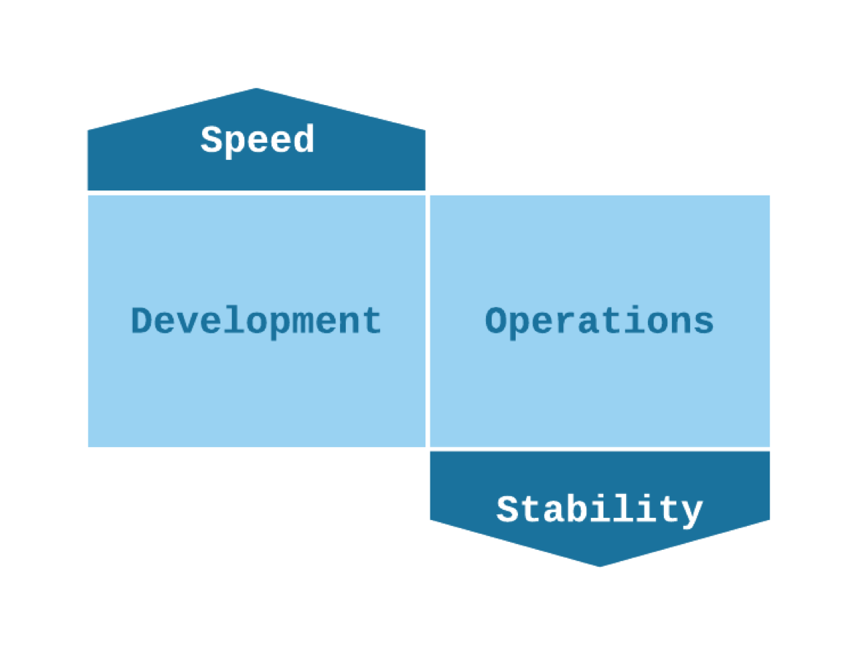
DevOps Culture
DevOps culture is about collaboration between Dev and Ops.
Under the traditional separation between Dev and Ops, Dev and Ops have different and opposing goals.

Slide 5

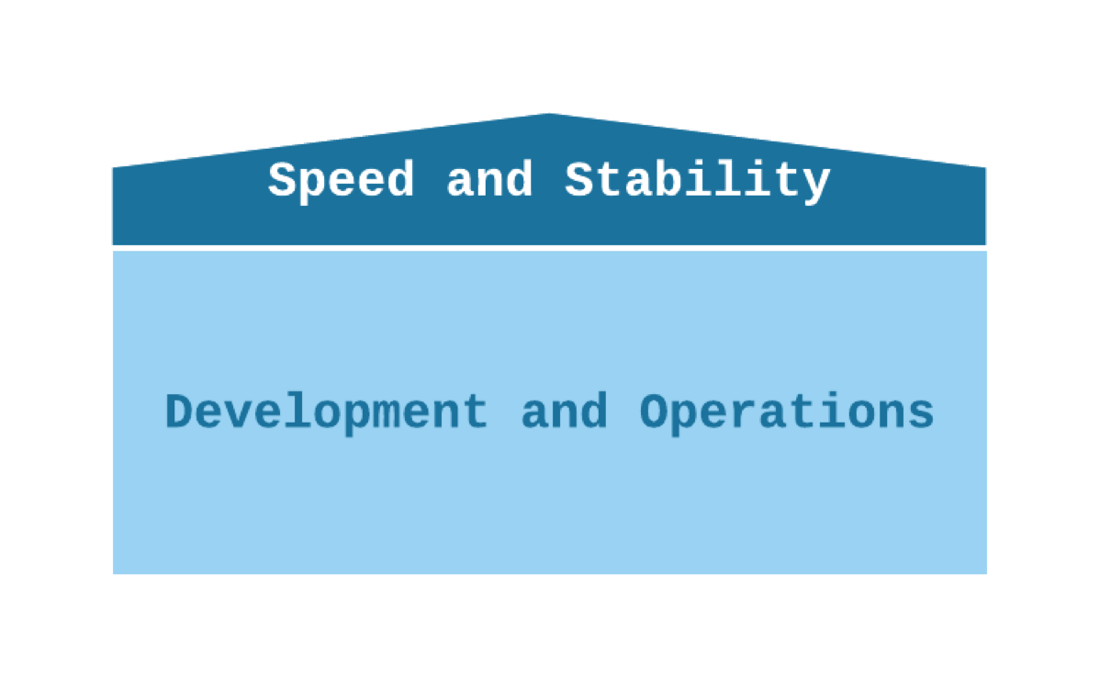
DevOps Culture
DevOps culture is about collaboration between Dev and Ops.
With DevOps, Dev and Ops work together and share the same goals.

Slide 6

The Goals of DevOps Culture
With DevOps:
Dev and Ops are playing on the same team
Dev and Ops share the same goals
These goals include things like:
Fast time-to-market (TTM)
Few production failures
Immediate recovery from failures

Slide 7

DevOps Essentials
A Story of DevOps vs. Traditional Silos
DevOps Essentials

Slide 8


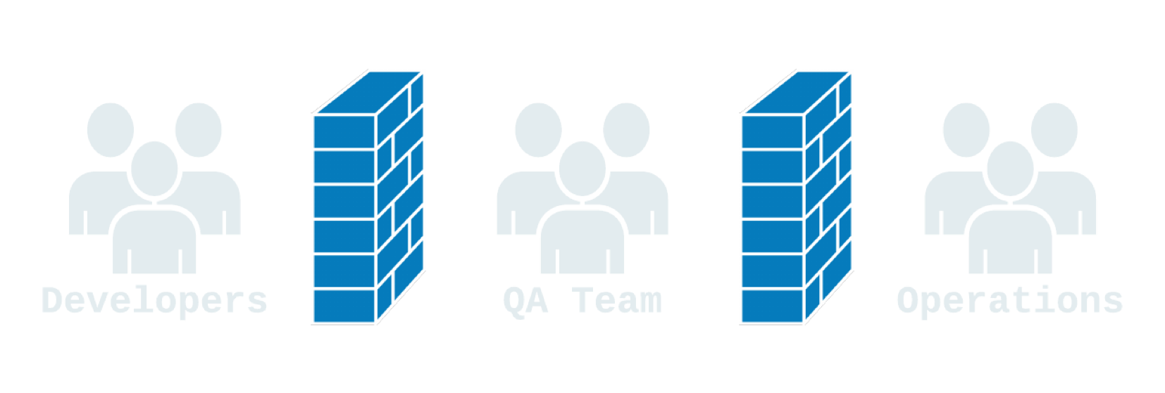
The Story of Some Code: Traditional Silos
Devs write code
“throw it over the wall” to QA
Code bounces back and forth between Dev and QA as QA discovers problems and Devs fix them
Finally, it is ready for production

Slide 9


The Story of Some Code: Traditional Silos
QA/Dev “throws the code over the wall” to Operations
Oh no! There’s a problem. Ops throws it back over the wall to Dev
Each group’s domain is a “black box” to the other groups
“Our systems are fine; it’s your code!”
“But the code works on my machine!”

Slide 10

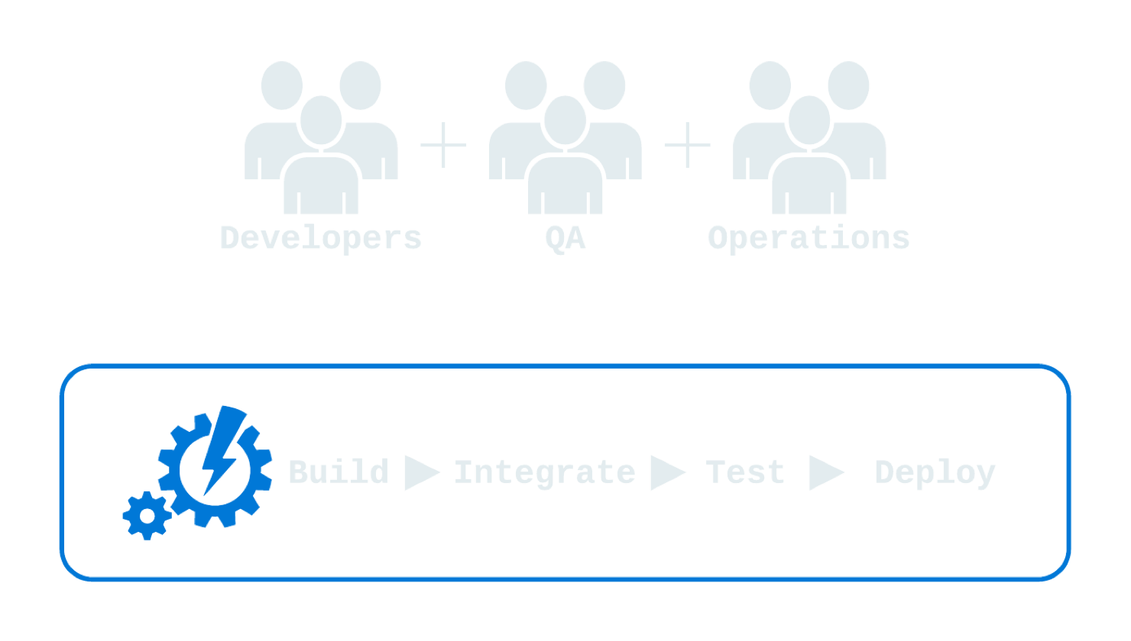

The Story of Some Code: DevOps
Devs write code
Code commit triggers automated build, integration, and tests
QA can get their hands on it almost immediately
Once it is ready, kick off an automated deployment to production

Slide 11


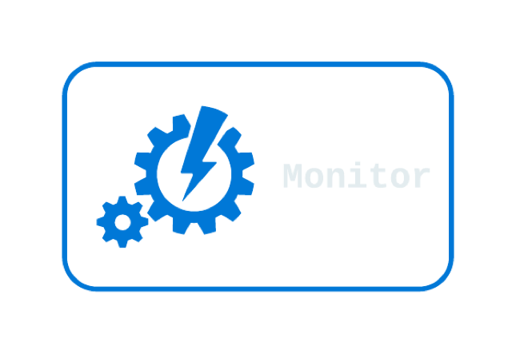
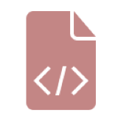
The Story of Some Code: DevOps
Oh no! The latest deployment broke something in production!
Fortunately, automated monitoring notified the team immediately
The team does a rollback by deploying the previous working version, fixing the problem quickly
An hour later, the dev team was able to deploy a fixed version of the new code

Slide 12

Why do DevOps?
Happier teams:
Tech employees tend to be happier doing DevOps than under traditional silos
More time innovating and less time putting out fires
Devs don’t feel like they have to fight to get their work out there
Operations people don’t have to fight Dev to keep the system stable
Happier customers:
DevOps lets you give customers the features they want quickly
And you don’t have to sacrifice stability to do it!

Slide 13

The Periodic Table of DevOps Tools
We can’t cover every tool in this course, so we’ll just briefly introduce you to some of the most popular ones
The kind folks at Xebia Labs have created a neat way to explore some of the popular tools associated with DevOps: The Period Table of DevOps Tools
Source: https://xebialabs.com/periodic-table-of-devops-tools/
A PDF Version can be found in the course downloads

Slide 14


Slide 15

DevOps Essentials
Continuous Integration
DevOps Essentials

Slide 16

What is Continuous Integration?
Continuous Integration (CI): the practice of frequently merging code changes done by developers
Traditionally, developers would work separately, perhaps for weeks at a time, and then merge all of their work together at the end in one large effort
Continuous integration means merging constantly throughout the day, usually with the execution of automated tests to detect any problems caused by the merge
Merging all the time could be a lot of work, so to avoid that it should be automated!

Slide 17

What does Continuous Integration look like?
Continuous integration is usually done with the help of a CI server.
When a developer commits a code change, the CI server sees the change and automatically performs a build, also executing automated tests.
This occurs multiple times a day.
If there is any problem with the build, the CI server immediately and automatically notifies the developers.
If anyone commits code that “breaks the build” they are responsible for fixing the problem or rolling back their changes immediately so that other developers can continue working.

Slide 18

Why do Continuous Integration?
Early detection of certain types of bugs – If code doesn’t compile or an automated test fails, the developers are notified and can fix it immediately. The sooner these bugs are detected, the easier they are to fix!
Eliminate the scramble to integrate just before a big release – The code is constantly merged, so there is no need to do a big merge at the end.
Makes frequent releases possible - Code is always in a state that can be deployed to production.
Makes continuous testing possible – Since the code can always be run, QA testers can get their hands on it all throughout the development process, not just at the end.
Encourages good coding practices – Frequent commits encourages simple, modular code.

Slide 19

DevOps Essentials
Continuous Delivery and Continuous Deployment
DevOps Essentials

Slide 20

What is Continuous Delivery?
Continuous Delivery (CD): the practice of continuously maintaining code in a deployable state
Regardless of whether or not the decision is made to deploy, the code is always in a state that is able to be deployed.
Some use the terms continuous delivery and continuous deployment interchangeably, or simply use the abbreviation CD

Slide 21

What is Continuous Deployment?
Continuous Deployment: the practice of frequently deploying small code changes to production
Continuous delivery is keeping the code in a deployable state. Continuous deployment is actually doing the deployment frequently
Some companies that do continuous deployment deploy to production multiple times a day
There is no standard for how often you should deploy, but in general the more often you deploy the better!
With continuous deployment, deployments to production are routine and commonplace. They are not a big, scary event

Slide 22

What does Continuous Delivery and Continuous Deployment look like?
Each version of the code goes through a series of stages such as automated build, automated testing, and manual acceptance testing. The result of this process is an artifact or package that is able to be deployed.
When the decision is made to deploy, the deployment is automated. What the automated deployment looks like depends on the architecture, but no matter what the architecture is, the deployment is automated.
If a deployment causes a problem, it is quickly and reliably rolled back using an automated process (hopefully before a customer even notices the problem!)
Rollbacks aren’t a big deal because the developers can redeploy a fixed version as soon as they have one available.
No one grips their desk in fear during a deployment, even if the deployment does cause a problem.

Slide 23

Why do Continuous Delivery and Continuous Deployment?
Faster time-to-market – Get features into the hands of customers more quickly rather than waiting for a lengthy deployment process that doesn’t happen often.
Fewer problems caused by the deployment process – Since the deployment process is frequently used, any problems with the process are more easily discovered.
Lower risk – The more changes are deployed at once, the higher the risk. Frequent deployments of only a few changes are less risky.
Reliable rollbacks – Robust automation means rollbacks are a reliable way to ensure stability for customers, and rollbacks don’t hurt developers because they can roll forward with a fix as soon as they have one.
Fearless deployments – Robust automation plus the ability to rollback quickly means deployments are commonplace, everyday events rather than big, scary events.

Slide 24

DevOps Essentials
Configuration Management
DevOps Essentials

Slide 25

What is Configuration Management?
Configuration Management: maintaining and changing the state of pieces of infrastructure in a consistent, maintainable, and stable way
Changes always need to happen – configuration management is about doing them in a maintainable way
Configuration management allows you to minimize configuration drift – the small changes that accumulate over time and make systems different from one another and harder to manage
Infrastructure as Code is very beneficial for configuration management

Slide 26

What does configuration management look like?
Here is an Example
You need to upgrade a software package on a bunch of servers:
Without good configuration management, you log into each server and perform the upgrade. However, this can lead to a lot of problems. Perhaps one server was missed due to poor documentation, or perhaps something doesn’t work while the versions are temporarily mismatched between servers, causing a lot of downtime while you do the upgrade.
With good configuration management, you define the new version of the software package in a configuration file or tool and automatically roll out the change to all of the servers.
Configuration management is about managing your configuration somewhere outside of the servers themselves

Slide 27

Why do configuration management?
Save time – It takes less time to change the configuration.
Insight – With good configuration management, you can know about the state of all pieces of a large and complex infrastructure.
Maintainability - A more maintainable infrastructure is easier to change in a stable way.
Less configuration drift – It is easier to keep a standard configuration across a multitude of hosts.

Slide 28

DevOps Essentials
Monitoring
DevOps Essentials

Slide 29

What is Monitoring?
Monitoring: The collection and presentation of data about the performance and stability of services and infrastructure
Monitoring tools collect data over things such as:
Usage of memory
cpu
disk i/o
Other resources over time
Application logs
Network traffic
etc.
The collected data is presented in various forms, such as charts and graphs, or in the form of real- time notifications about problems

Slide 30

What does Monitoring look like?
Real-time notifications:
Performance on the website is beginning to slow down
A monitoring tool detects that response times are growing
An administrator is immediately notified and is able to intervene before downtime occurs
Postmortem analysis:
Something went wrong in production last night
It’s working now, but we don’t know what caused it
Luckily, monitoring tools collected a lot of data during the outage
With that data, developers and operations engineers are able to determine the root cause (a poorly performing SQL query) and fix it

Slide 31

Why do Monitoring?
Fast recovery – The sooner a problem is detected, the sooner it can be fixed. You want to know bout a problem before your customer does!
Better root cause analysis – The more data you have, the easier it is to determine the root cause of a problem.
Visibility across teams – Good monitoring tools give useful data to both developers and operations people about the performance of code in production.
Automated response – Monitoring data can be used alongside orchestration to provide automated responses to events, such as automated recovery from failures.

Slide 32

DevOps Essentials
Tools for Build Automation and Continuous Integration
DevOps Essentials

Slide 33

Build Automation Tools
Build automation – Automated processing of code in preparation for deployment
What tools you use for build automation usually depend on programming languages and frameworks A few examples:
Java – ant, maven, gradle
Javascript – npm, grunt, gulp
Make – widely used in Unix-based systems
Packer – build machine images and containers

Slide 34

Continuous Integration Tools
Continuous Integration – Continuously merging code into a single branch or mainline
Continuous Integration tools usually consist of a server that integrates with source control
When source code is changed, the server responds by executing an automated build

Slide 35

Continuous Integration Tools
Jenkins:
Open source – fork of Hudson
Widely used
Java servlet-based
TravisCI:
Open source
Built around Github integration
Executes builds in clean VMs

Slide 36

DevOps Essentials
Tools for Configuration Management
DevOps Essentials

Slide 37

Configuration Management Tools
Configuration Management – Managing and changing the state of pieces of infrastructure in a consistent and maintainable way
Configuration management tools are a great way to implement infrastructure as code
Ansible:
Open source
Declarative configuration
YAML configuration files
No control server needed – but Ansible tower is available
No agents needed, just python and ssh.
Puppet:
Declarative configuration
Manage state through a UI
Custom modules use Puppet DSL
Pushes changes to clients using a control server and agents installed on clients

Slide 38

Configuration Management Tools
Cobber
Cobbler helps by automating the process of provisioning servers from bare metal, or when deploying virtual machines onto various hypervisors.
Cobbler is a Linux installation server that allows for rapid setup of network installation environments
Used for build of Physical as well as virtual servers via Kickstart.
Bladelogic Automation tool
Graphical Web interface which can be used for automation.
Provided by BMC and Licensed.
Any single task on multiple servers can be achieved via this.
We can schedule the Jobs to run particular time.

Slide 39

DevOps Essentials
Tools for Virtualization and Containerization
DevOps Essentials

Slide 40

Virtualization Tools
Virtualization – Managing resources by creating virtual rather than physical machines
Hypervisor – Runs on bare metal and manages virtual machines (VMs)
Examples:
VMWare ESX and ESXi
Microsoft Hyper-V
Citrix XenServer

Slide 41

Containerization
Containers – Lightweight, isolated packages containing everything needed to run a piece of software
Require fewer resources than VMs – VMs contain an entire OS plus virtual versions of all the hardware
Containers have the bare minimum needed to run the software
Docker – Docker is currently the leading container technology
Containers are still relatively new but very useful for DevOps!

Slide 42

DevOps Essentials
Tools for Monitoring
DevOps Essentials

Slide 43

Monitoring Tools
Monitoring – Collecting and presenting data about the state and performance of applications
There are different types of monitoring:
Infrastructure monitoring – focuses on things related to infrastructure
Examples: CPU, ram
Application Performance Monitoring (APM) – focuses on performance and stability of individual parts of an application
Examples: response times, logs

Slide 44

Aggregation and Analytics Tools
Aggregation and Analytics are about collecting monitoring data and doing something with it
Most monitoring tools have some aggregation and analytics features
Elastic Stack – pump data in and quickly create views to aggregate data and easily detect and diagnose problems

Slide 45

DevOps Essentials
Tools for Orchestration
DevOps Essentials

Slide 46

Orchestration Tools
Orchestration – automation that supports processes and workflows, such as provisioning resources.
Lets you do things like:
Scale up and scale down applications on request
Auto scale applications based on usage
Create self-healing systems by spinning down unhealthy nodes and replacing them with new ones

Slide 47

Orchestration Tools
Kubernetes:
Open source
Orchestration server
Manage containerized apps across multiple hosts

Slide 48

DevOps Essentials
DevOps and Amazon Web Services
DevOps Essentials

Slide 49

Amazon Web Services DevOps Features
Amazon EC2 (Elastic Compute Cloud):
IaaS
Easily scalable
Full control over your cloud infrastructure
Integrates with tons of tools, both AWS and 3rd-party

Slide 50

Amazon Web Services DevOps Features
Continuous Integration, Delivery, and Deployment:
AWS CodeBuild – continuous integration
AWS CodeDeploy – continuous deployment
AWS CodePipeline – full code pipeline from build to deploy
AWS CodeStar – integrates all parts of the process with project management tools and JIRA issue tracking

Slide 51

Amazon Web Services DevOps Features
Infrastructure as Code:
CloudFormation – Stack templating engine, YAML or JSON-based
Ops Works – IaC with Chef
Serverless / FaaS:
AWS Lambda – run server less functions on AWS
Monitoring:
Amazon Cloudwatch – track metrics and logs, set alarms, and automate responses to monitoring data

Slide 52

Next Steps
Go do DevOps!
Thank You

